Slide 1

CSC492H5 UI/UX Design Specialist: Final Thoughts

Slide 2

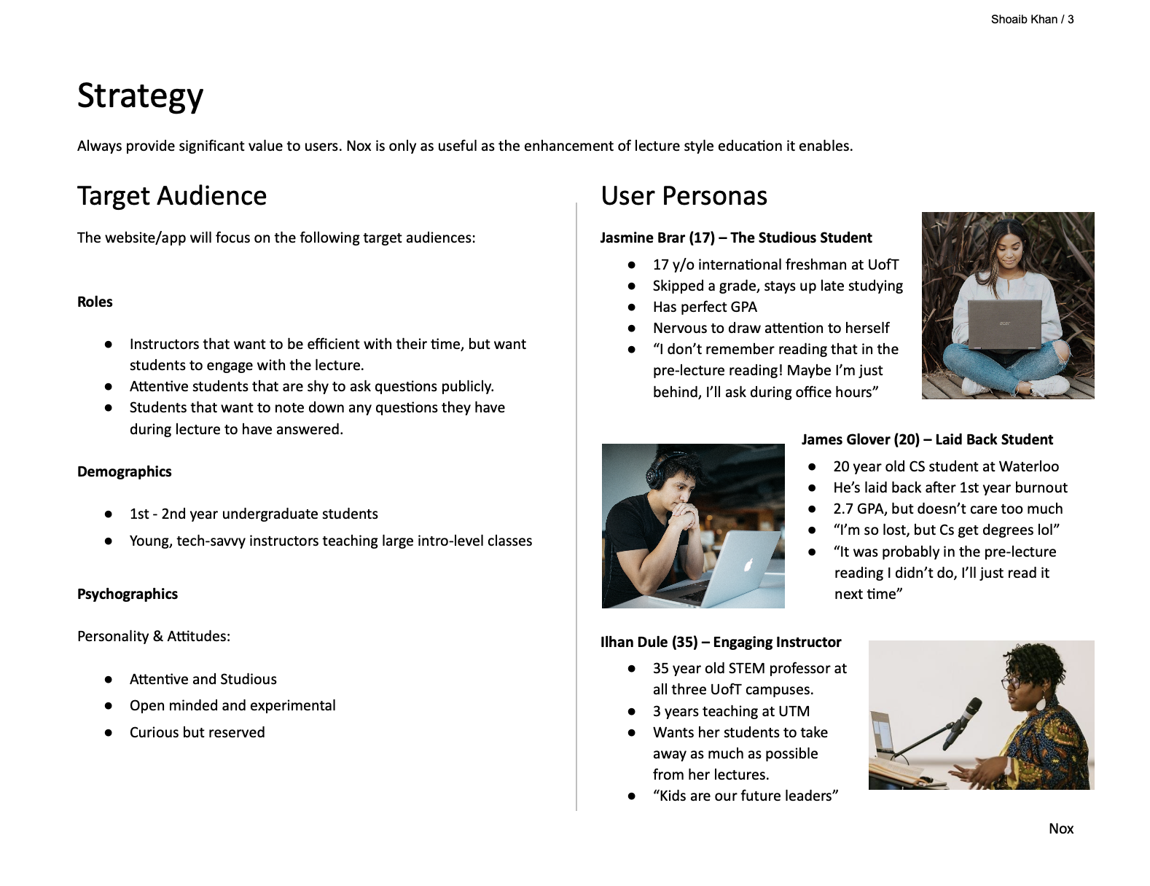
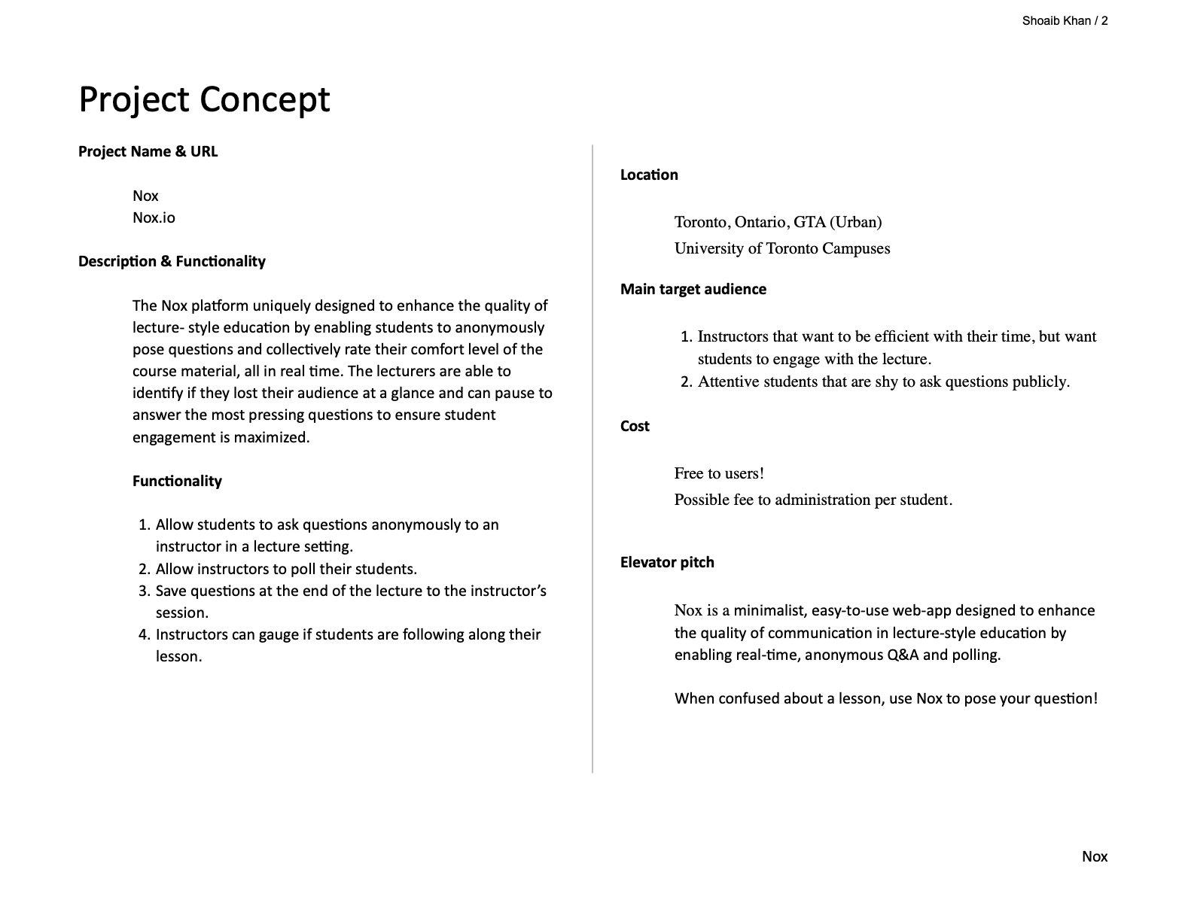
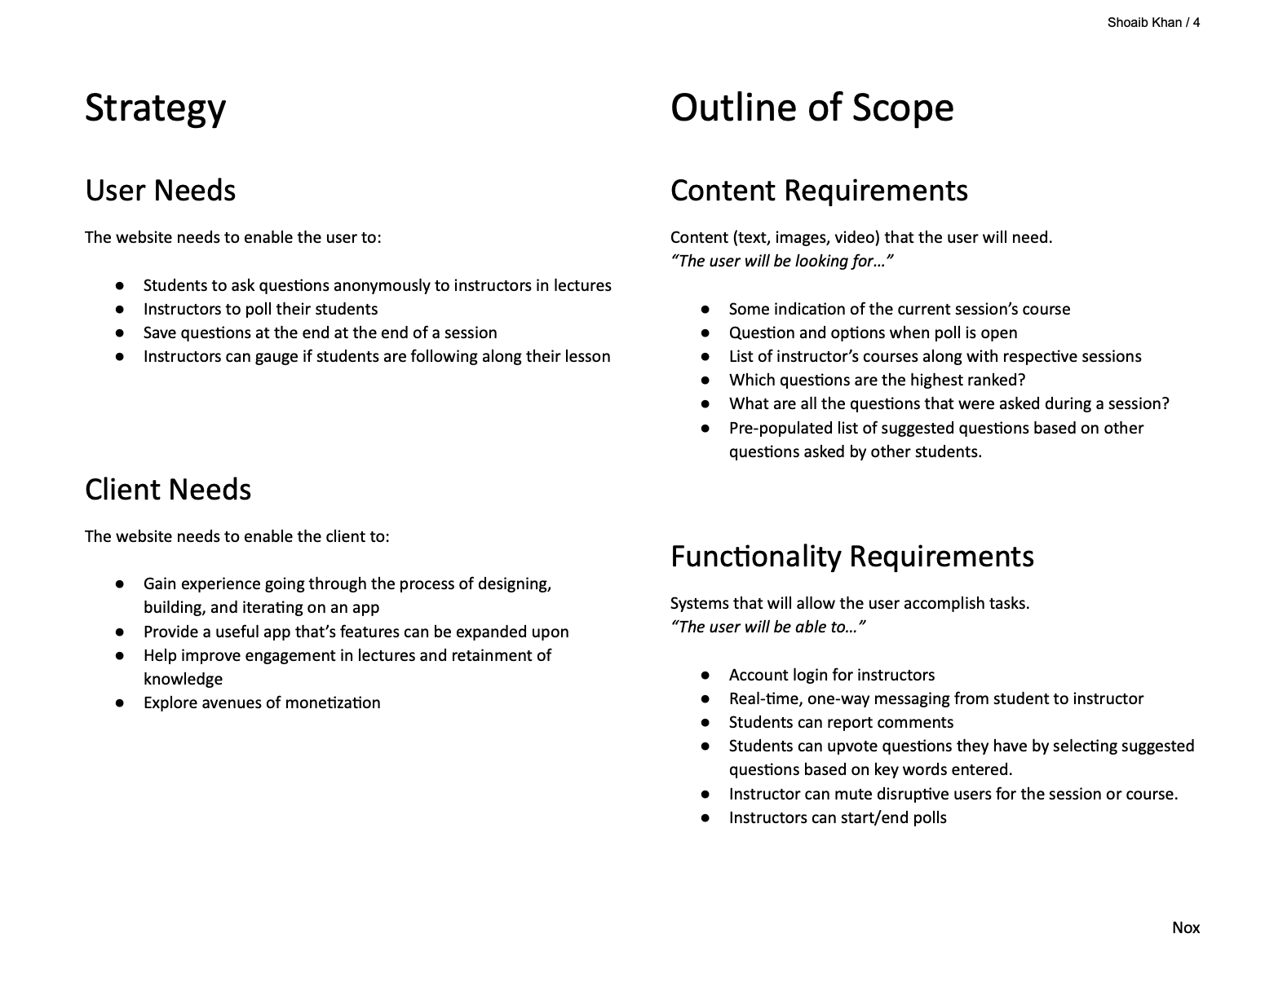
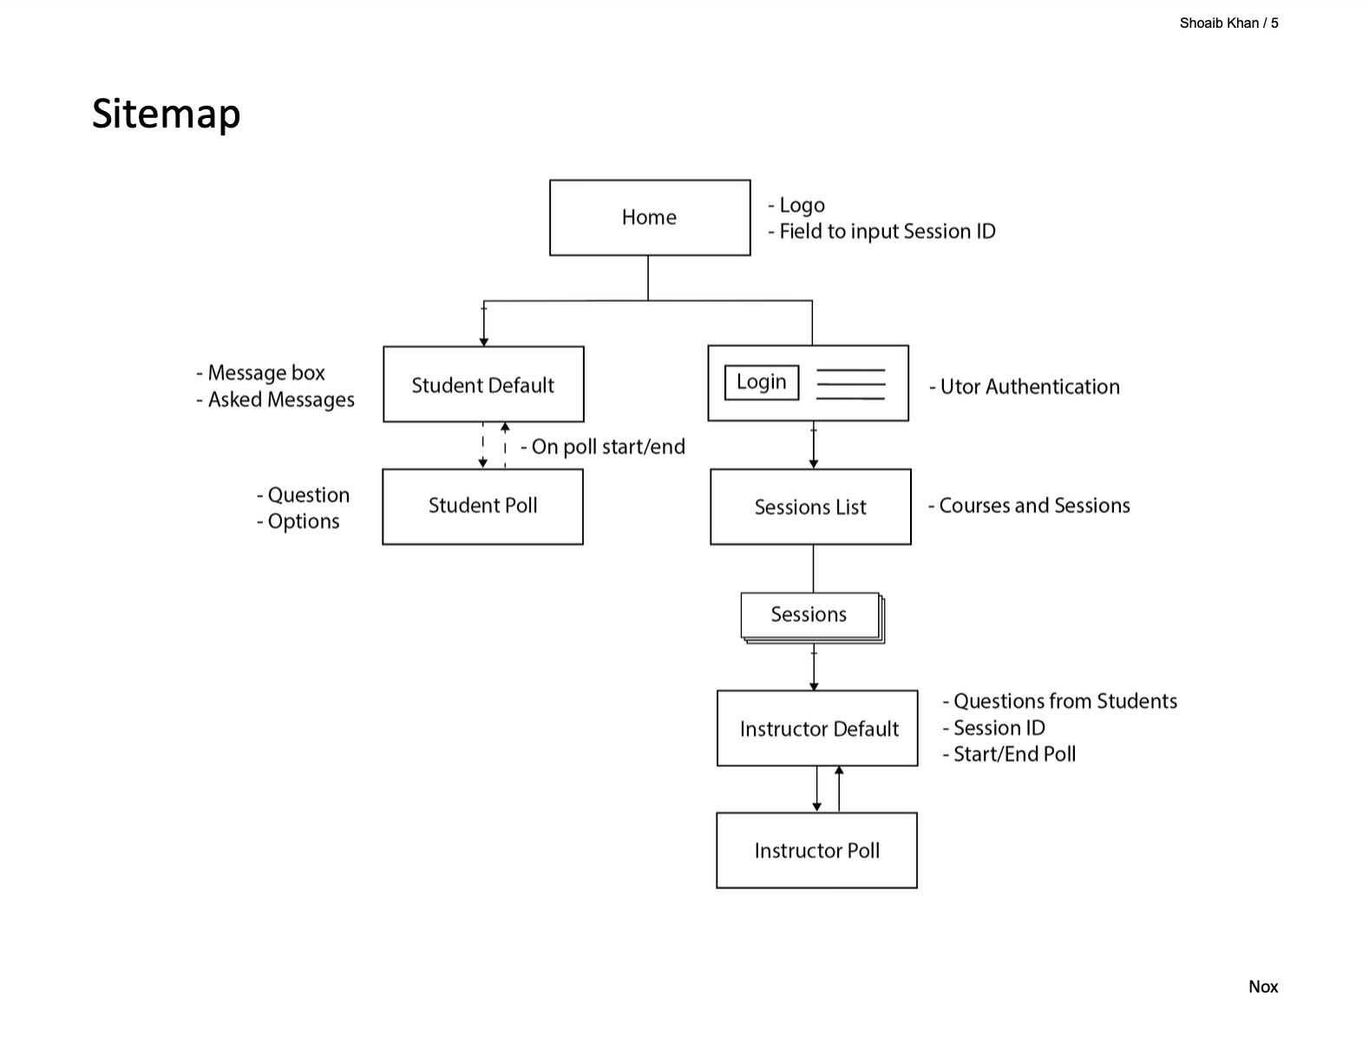
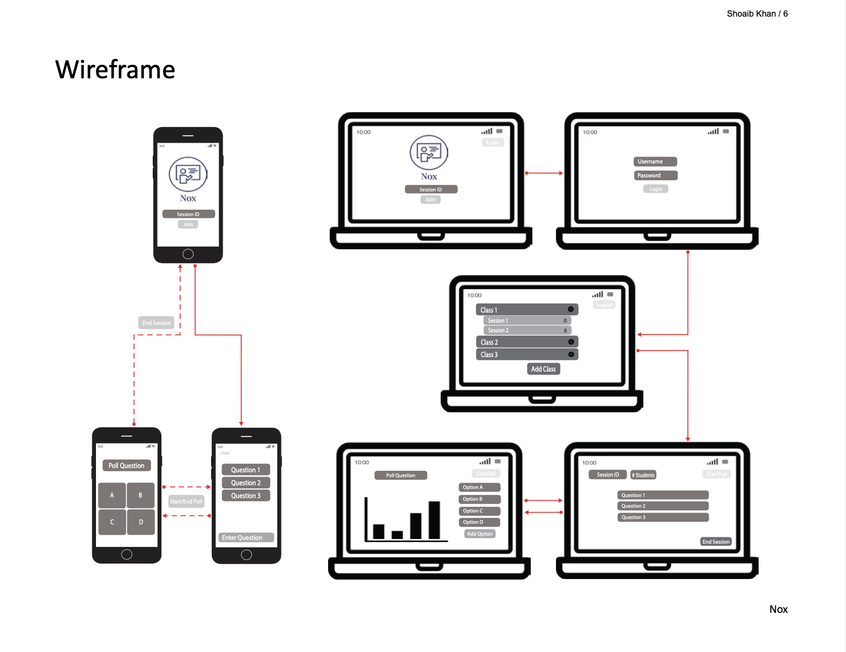
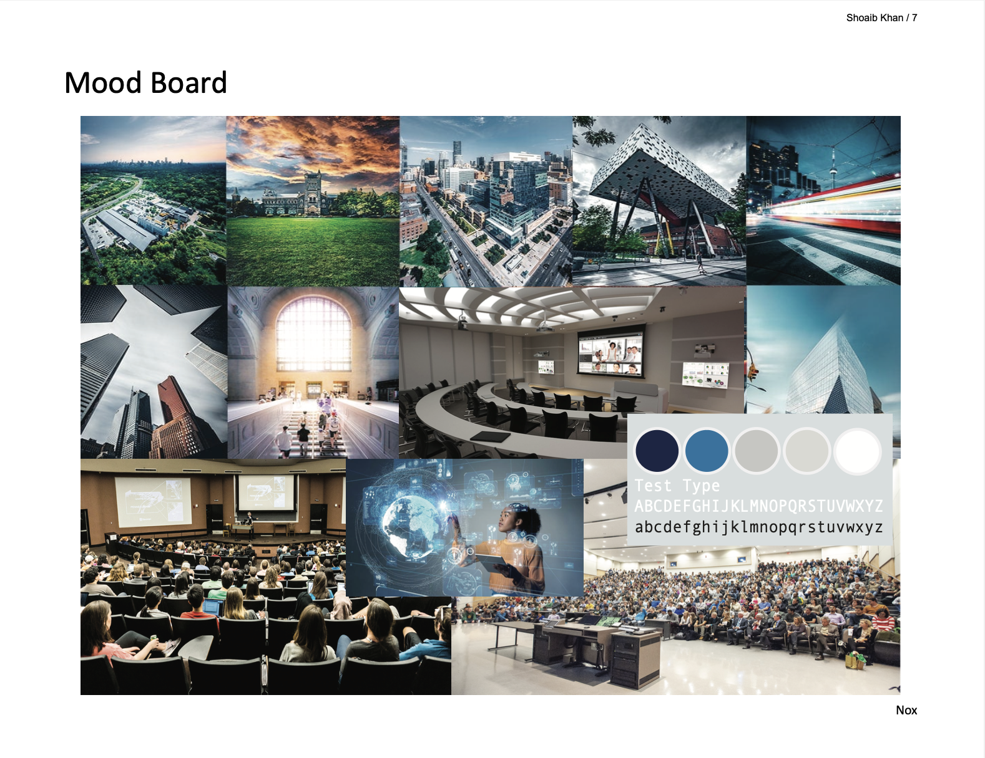
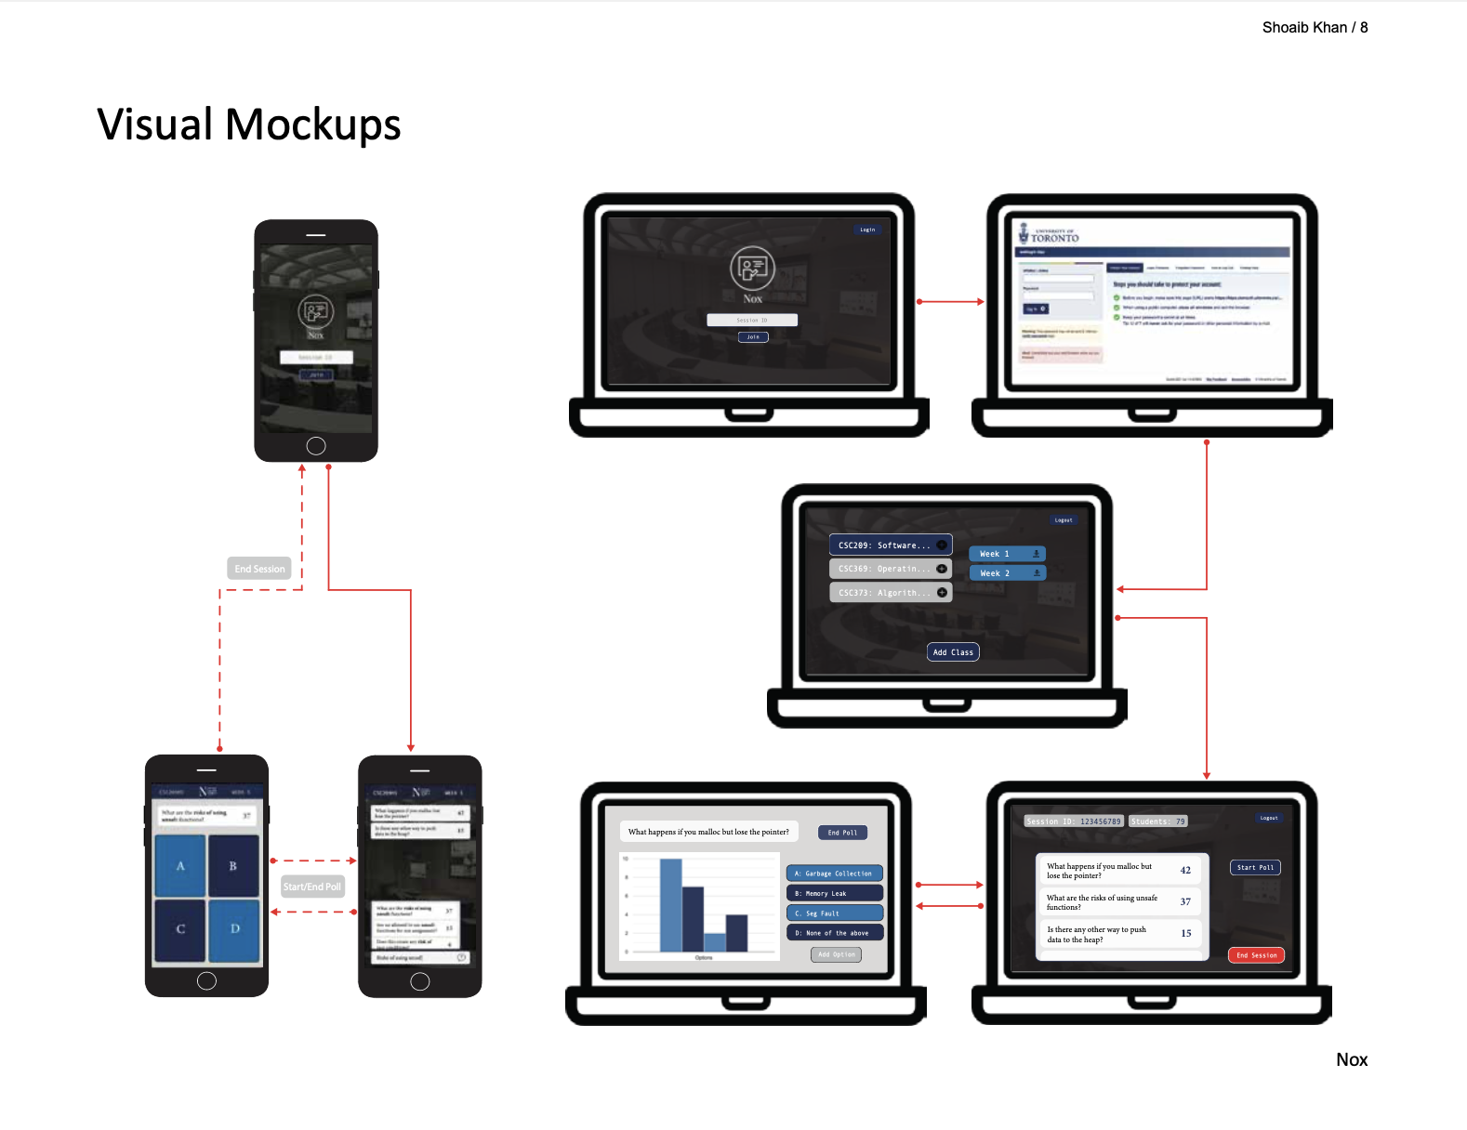
Notes:
The final deliverable for a UI/UX design proposal is called a Design Brief. Let’s take a closer look at each step.
I’ll summarize the steps to starting a project from ideation to development.

Slide 3
1. Ideation
Description:
Good ideas come from good problems
What does it do?
Description and Functionality
Notes:
First step is Ideation. Here we ask the question What does it do?
We want to be as specific as we can and articulate our ideas clearly.
The central idea here is that good ideas come from good problems.
The purpose of this step is to narrow down the functionality that your product will have to keep it in focus throughout the rest of the project.
By the end of this step, you should have the Description and Functionality section down in your Project Brief.

Slide 4
2. User Research
Description:
Research & Development
Audience & Rationale
Goals & Outcomes
Checkout the competition
Develop your idea
User Personas
Notes:
Next we have User Research. Here, we answer How does it work?
First step is Research and Development. Here we checkout the competition and ask What apps exist that do the thing? What apps do something similar? What apps are content adjacent? What unrelated apps are structural models (nice designs to copy)? Then we map out ALL the possible directions our app can take.
Then we move onto Audience and Rationale. Here we think about ALL the possible group of users of our product and create a one-line user persona of each category.
Lastly we think about the goals of both the User and the Client. The user is the person who is going to be using the app, and the client is who you’re designing the product for.
The purpose of this step is to identify who your target audience is, what they would use the product for and what their needs and the client’s needs are.
You need to strike a balance between the needs of the clients and the users as they don’t always align. This is yet another step in making your idea more concrete.
By the end of this step, you should have the Target Audience, User Personas, and User and Client needs down.

Slide 5
3. Naming and Mission
Description:
Branding with words
Naming
Tagline
Mission
Notes:
Next, we have the naming and mission. This is coming up with some unified ethos of the product. Both internally for the client and for external users.
Pick out keywords and create a mindmap on how they relate to each other and the product. The naming would be more creative and the mission would be more descriptive.
The purpose of this step is to set an ethos that the product embodies. Ideally, this is what would appeal to your target audience.
By the end of this step, you should have your Product name, Tagline, Mission, and an Elevator Pitch.

Slide 6
4. Mapping Content and Interactions
Description:
Mapping Content
Mapping Interactions
Content Requirements
Functionality Requirements
Notes:
Next, we map the content and interaction requirements the product will have.
You can do this by creating flow charts that map out the navigation. Your maps HAVE to make sense. They need to have clarity, hierarchy, modularity, and growth potential.
The purpose of this step is to provide a sort of checklist on the main content and functionality the product should have.
By the end of this step, you should have your Outline of Scope complete with the Content and Functionality Requirements.

Slide 7
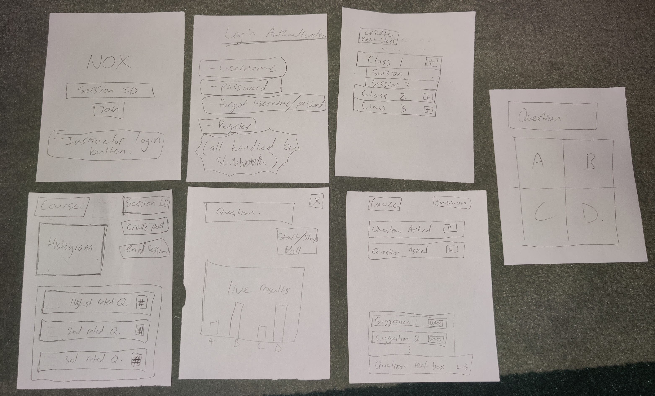
5. User Testing
Description:
Paper Prototype
Test the Flow
Notes:
Next, we move onto User Testing.
This consists of creating a paper prototype based on your content and functionality maps and getting users to test it out.
The hope is to catch any logic flaws early on.
Some questions that will help you guide your testing include:
Before even looking at the prototype, what do you expect to do with this app?
What is the first thing you notice on this screen?
What is the first thing you would do on this screen?
By the end of this step, you should be confident that your Content and Functionality Requirements are validated and the flow works well.

Slide 8
6. Creating a Sitemap
Description:
Flow Validated
Create Digital Sitemap
Notes:
Next, we move onto the Sitemap.
Now that our functionality and content requirements are validated and any kinks in the flow have been worked out, we create a sitemap which lays out the flow of interactions and content on each page.
By the end of this step, you should have your sitemap.

Slide 9
7. Look and Feel
Description:
Mood Board
B&W Wireframe
Notes:
Next, we move onto the Look and feel.
This is where we begin getting some design elements in. We layout basic outlines of what our pages should look like based on our sitemap and content and functionality requirements.
We then create a mood board which sets the theme of our product. This includes styling, colour, typography, etc.
By the end of this step, you should have your preliminary wireframe and a moodboard guiding your UI of the product.

Slide 10
8. Visual Mockup and Clickable Prototype
Description:
Visual Mockup
Clickable Protype
Figma/InVision
Wireframe + Moodboard
Notes:
Finally we move onto the Visual Mockup and Clickable Protypes.
This is where we combine the preliminary wireframe and the moodboard into a final mock up. This is what the end product should look like after coding it up.
This basically just added the skin onto the skeleton which was the low-fidelity mock-up
The clickable prototype should mimic our functionality as closely as possible.
Desktop: https://www.figma.com/proto/46ADauiwYJoKSDppoMhsez/Nox-Second-Prototype?node-id=153%3A42&starting-point-node-id=153%3A42
Mobile: https://www.figma.com/proto/46ADauiwYJoKSDppoMhsez/Nox-Second-Prototype?node-id=2%3A22&starting-point-node-id=2%3A22

Slide 11
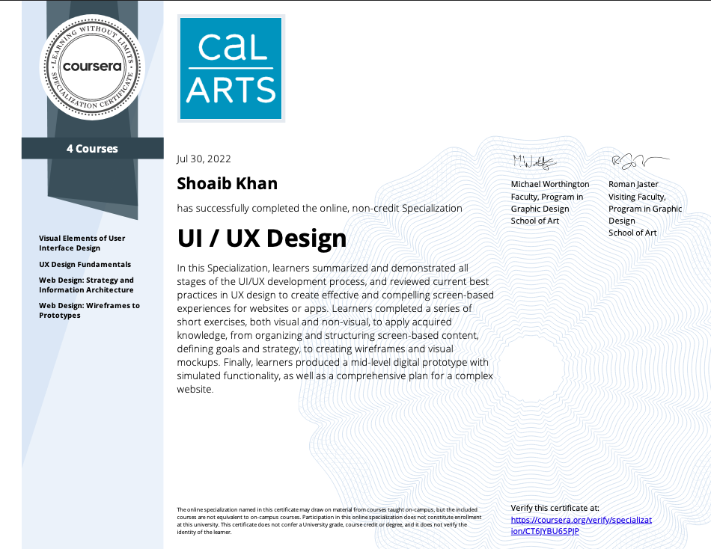
Notes:
And that wraps up this specialist. As critical as I was on Courses 3 and 4, I think they would be crucial for students without a CS background.
But overall, I think this specialist did a solid job of laying out the UI/UX design process. I cut down on the stuff I found unnecessary and now have a systematic approach I can use to guide me through the design process of any project I may work on in the future. I truly feel this will help me be more intentional and give me a better shot at building a solid final product.
One thing I would do differently is I’d start a project from scratch and one that is more content rich. I feel I could have taken a lot more from the specialist had I started with a clean slate. That way I wouldn’t have the tendency to shape the course work to fit my vision of what the product should look like.

